Slide 1
SOLVING REAL-WORLD OPTIMIZATION PROBLEMS WITH AI & OR
RESEARCH PORTFOLIO
2 AUGUST 2024
JOE WALDY
Notes:
Good Morning Everyone
My name is Waldy
Thank you for taking the time to attend my thesis defense presentation.
First, I would like to acknowledge the evaluation committee,
Prof Lau, my supervisor and the chair
Prof Shih-Fen, thank you for making the time despite being on sabbatical
Prof Arunesh, thank you for dialling in from the US at such a late hour
And Prof Tien, thank you for agreeing to be part of this committee at a short notice
The topic of my dissertation is

Slide 2
OUTLINE
INTRODUCTION
RESEARCH OVERVIEW
PhD Thesis
Industry
SELECTED RESEARCH PROJECTS
RL Approach to solve Dynamic Routing and Scheduling Problem
Coordinating Multi-Agent Routing and Scheduling
Multi-Agent Pathfinding Problem for Autonomous Mobile Robot
SELECTED PUBLICATIONS

Slide 3


RESEARCH OVERVIEW (PhD)
INTRODUCTION
RL Approach to Coordinate Real-World Multi-Agent Dynamic Routing and Scheduling
RL Approach to Solve DYNAMIC Routing and Scheduling Problem
Coordinating MULTI-AGENT Routing and Scheduling
RL Approach to Coordinate MULTI-AGENT DYNAMIC Routing and Scheduling
Value Function Approximation (VFA) via Temporal-Difference (TD) Learning with Heuristic
Evaluation 1: Same-Day Delivery Routing Problem (SDDP)(ICAPS’20) [1]
Evaluation 2: Bi-Objective Dynamic Police Patrol Dispatching and Rescheduling Problem (DPRP)(ICAPS’22) [3]
Coordinating Multi-Agent Routing and Scheduling via Iterative Best Response
Evaluation: Multi-LSP VRP with Location Congestion (EUMAS’21)[2]
Multi-Agent VFA (MAVFA) via Value Function Factorization with Planning Heuristic
Evaluation: Multi-Agent DPRP (IJCAI’23)[4]
Home Team Science and Technology Agency (HTX)
Industry Research Collaborators
https://www.htx.gov.sg/
https://unicen.smu.edu.sg/
Notes:
Let me begin by going through the structure of my presentation today.
First, I will give a brief introduction & background of my dissertation, which include the motivation, the terminologies used
After which, I will go into the details on my 3 contributions.
First, I address specifically the dynamic aspect of routing and scheduling problem
Second, I address the multi-agent aspect of..
Third, I address both aspects and building up on my 2 earlier contributions
Since I have covered the first and second in my proposal, I will touch mainly on the motivation and contribution w.r.t to the existing research in this presentation and provide more details on my third contributions and show how the 3rd contribution is built upon the earlier 2 contributions.
I will then conclude by pointing out two interesting future works that can spring out of the work done in this dissertation.
How 1st and 2nd contributions linked to 3rd contribution
Set the expectation, focus on positioning my work and contribution the light of the literature
Detailed 1st and 2nd Contributions have been covered in proposal stage, will go into the detail for 3rd contributions

Slide 4



RESEARCH OVERVIEW (INDUSTRY)
INTRODUCTION
Optimization Engineer (Jan – Dec 2023)
Project Title: Multi-Agent Pathfinding for Autonomous Mobile Robot
Problem Statement: Improve the current pathfinding algorithm of AMR in Digital Twin Simulator
Proposed Method: Propose and implement Space-Time A* Search in Digital Twin Simulator
Project Title: Learning to Solve Multi-Agent Pickup and Delivery Problem
Problem Statement: How to improve material flow in the car assembly floor?
Proposed Method: Model the problem as MAPD and incorporate value function in task assignment and path planning (anticipatory vs myopic)
Research Engineer (Aug – Dec 2022)
Project Title: On Demand Delivery Assignment Recommender
Problem Statement: Recommend a list of dynamic delivery jobs to crowdsourced delivery drivers
Proposed Method: RL-based adaptive recommendation heuristic incorporating recommender systems and routing heuristic

Slide 5


RESEARCH OVERVIEW (INDUSTRY)
INTRODUCTION
Senior Manager, Operations Analysis & Improvement (Dec 2013 – Jan 2017)
Project Title: Strategic Manpower Planning Model
Problem Statement: Do we have enough manpower to support organizational needs in the future?
Proposed Method: Develop a discrete-event simulator using ExtendSim to simulate the manpower flow of the organization
Project Title: Facility Location Optimization Model
Problem Statement: Recommend locations for new security facilities to meet operations and public needs
Proposed Method: Model the problem as p-median problem and solve the corresponding MIP model
Undergraduate System Design Project (Aug 2009 – July 2010)
Project Title: Warehouse Layout Optimization via Simulation
Problem Statement: Design a layout for a new shipping warehouse
Proposed Method: Evaluate various layout designs by building simulation models using AutoMod

Slide 6
RL APPROACH TO SOLVE DYNAMIC ROUTING AND SCHEDULING PROBLEM
MOTIVATING PROBLEMS
PROPOSED APPROACH
EVALUATION

Slide 7
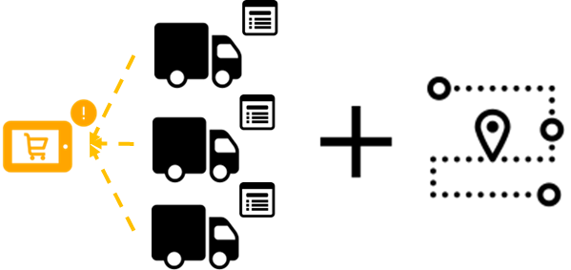
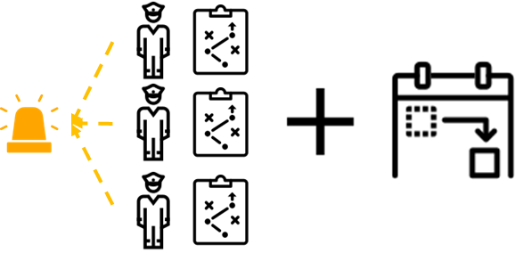
MOTIVATING PROBLEMS
DYNAMIC
Both problems are variants of DVRP with stochastic customers but with differences in problem settings and complexities
Dynamic VRP (DVRP) in Real-World
Dynamic Multi-Vehicle Same-Day Delivery Routing Problem (SDDP) (Urban Logistics)
Addition / cancellation of delivery requests may happen throughout the day
A vehicle needs to be assigned to serve the new request
Initial routes are disrupted
There is a need to reroute the vehicles quickly
Minimize travel time, waiting time and time window violations (Single-Objective)
Dynamic Bi-Objective Police Patrol Dispatching and Rescheduling Problem (DPRP) (Law Enforcement)
Incidents occur dynamically
Police agent need to be dispatched to the incident
Initial schedules are disrupted
There is a need to reschedule the plan quickly
Balance between 2 conflicting objectives – response time vs presence (Dual-Objective)
Notes:
From the two real-world application domains,

Slide 8
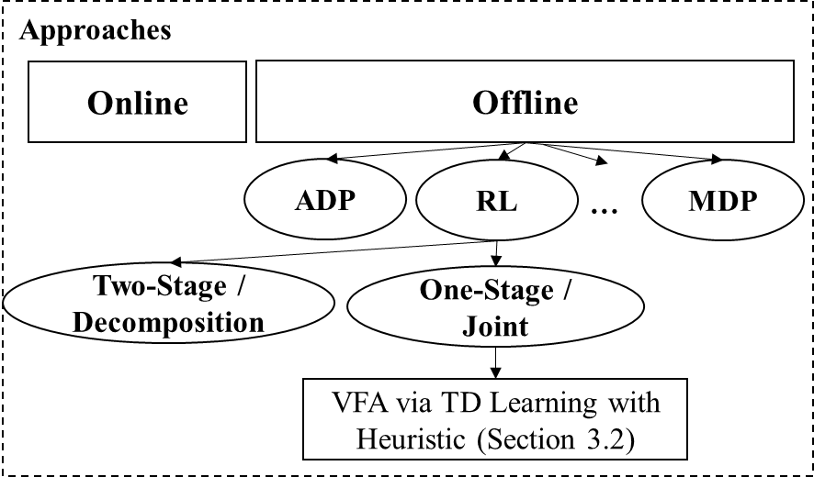
CONTRIBUTION TO EXISTING RESEARCH
DYNAMIC
MDP
Formulated as MDP but solved with heuristic
Mismatch between model and solution
(-) Computationally intractable to explore all possible states
Approaches to solving DVRP
Online
Sampling-based, rollout, lookahead
Multiple Scenario Approach (MSA)
(-) Slow, model-based
Approximate DP
More scalable than MDP
Approximate Value Iteration (AVI)
(-) Tabular-based, Monte-Carlo method, not sample efficient
RL
Great progress mainly in solving static VRP
Learn assign/dispatch policy then reroute/reschedule
No learning in second stage
(-) Fast, do not address the learning of complex action /routing /scheduling
Proposed Approach
Notes:
Why there is a need to propose new RL approach to solve DVRP
Only selected references provided. Full references can be found on the thesis

Slide 9
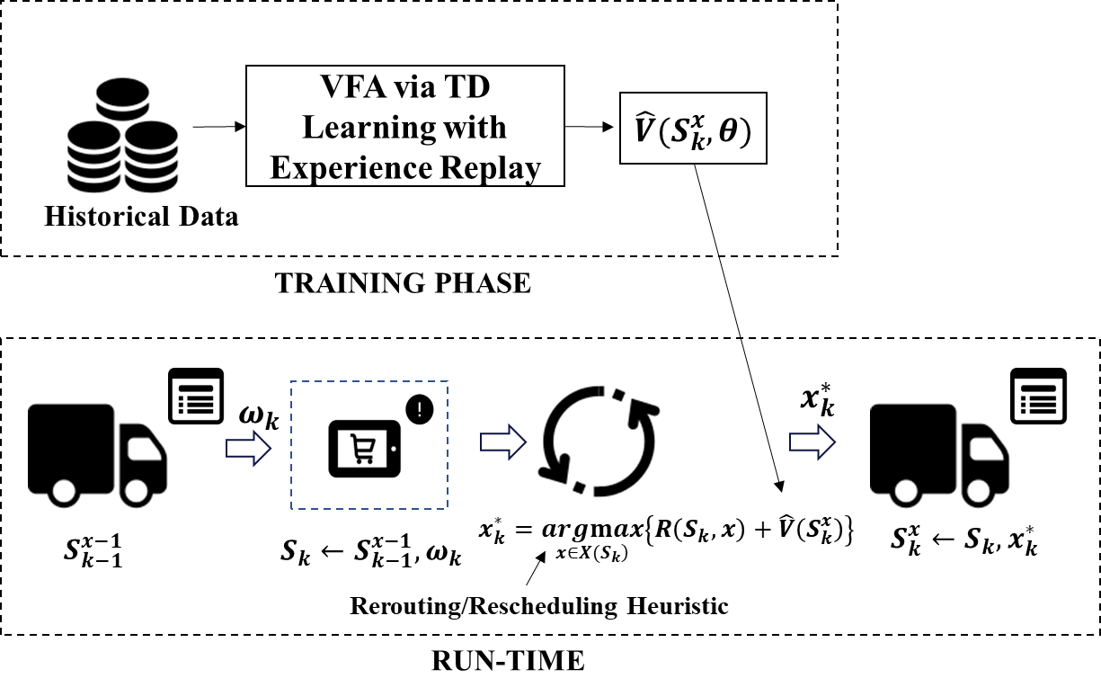
DYNAMIC
PROPOSED SOLUTION FRAMEWORK
Value Function Approximation via TD Learning with Heuristic
1. Value Function Approximation Step
2. Rerouting / Rescheduling Step
Notes:
To Recap
Learns the assignment and routing policies jointly
Value function represents the value of state after executing both decisions
Approximate value function with neural networks
Train the network using on-policy TD Learning
Learned value function guides the heuristic / objective value

Slide 10

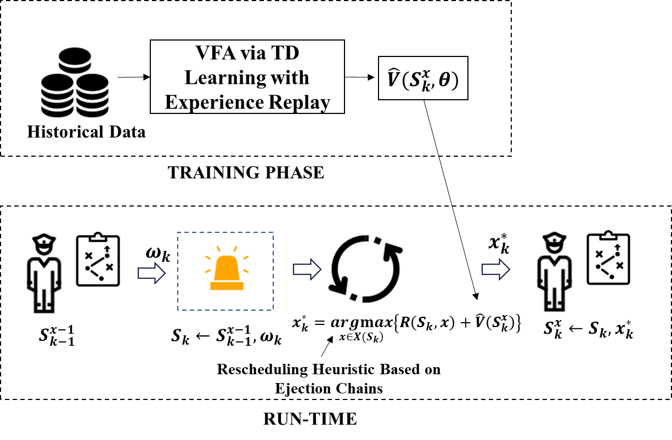
EXPERIMENTS
DYNAMIC
Evaluated the approach against 2 real-world problem domains
SDDP
DPRP
Simulated Annealing as rerouting heuristic
Rescheduling heuristic based on ejection chains
Notes:
Can use other “off-the-shelf” routing heuristics such as Tabu Search, Large Neighbourhood Search
Propose a new rescheduling heuristics

Slide 11
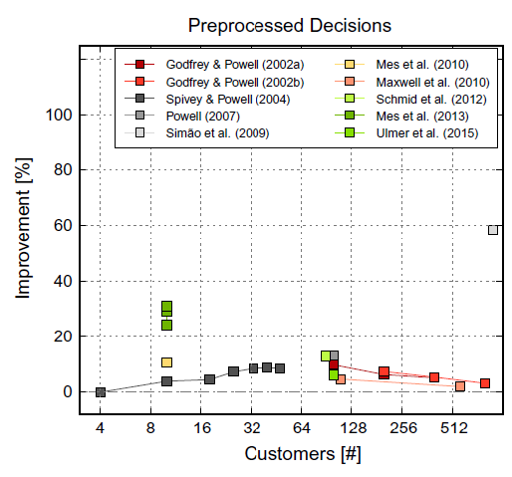
EXPERIMENTS
DYNAMIC
Outperform the following benchmark algorithms
Approximate Value Iteration (AVI) (offline)
Multiple Scenario Approach (MSA) (online)
Two-Stage Approach (RL)
Myopic
Our performance is comparable with those in the literature ^{[1]}
For moderately-sized customers (>20), other works managed to achieve improvements in the region of 5% to 10%.
^{[1]} U. Ritzinger, J. Puchinger, and R. F. Hartl, “A survey on dynamic and stochastic vehicle routing problems”, International Journal of Production Research, vol. 54, no. 1, pp. 215–231, 2016.
Notes:
Here are some key observations from our experiment…
Our proposed approach is statistically able to produce decisions with highest success rate in 3 out of 4 sectors. The % refers to the % improvement over myopic approach.
Notice that in sector B, greedy approach performs the best. This means that the common notion of dispatching nearest available agent may only work so some specific cases.
Lastly, Myopic approach is observed to perform well in a problem setting with small numbers of agent and patrol areas (Sector C)
This is possibly due to the fact that the problem scale is small and too trivial that don’t require sophisticated / anticipatory policy

Slide 12
COORDINATING MULTI-AGENT ROUTING AND SCHEDULING
MOTIVATING PROBLEM
PROPOSED APPROACH
EVALUATION
Notes:
My next contribution relates to addressing the multi-agent nature of routing and scheduling

Slide 13
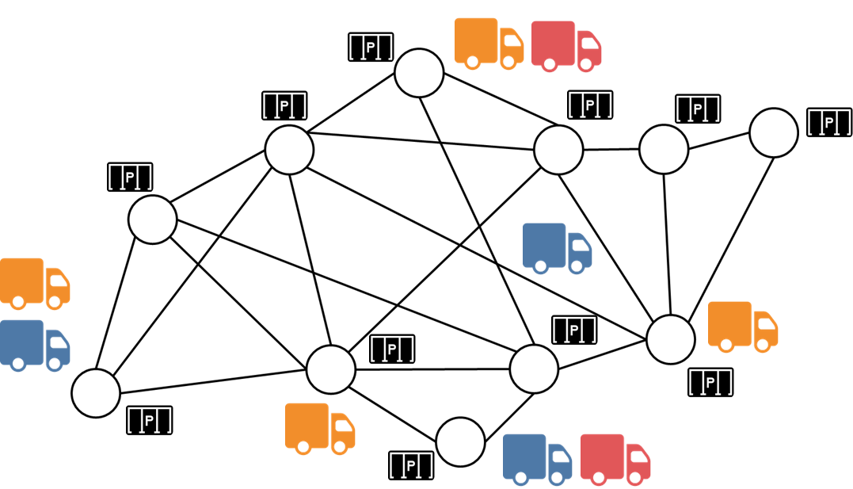
MOTIVATING PROBLEM
MULTI-AGENT
Multi-LSP VRP with Location Congestion (ML-VRPLC)
A multi-agent variant of VRP with Pickup and Delivery (VRPPDTW) with cumulative resource constraint at each location^{[1]}
Retail / Commercial / Warehouse Locations with limited parking bays
Multiple independent LSPs with their own fleets of vehicles and list of pickup delivery tasks
^{[1]} E. Lam and P. Van Hentenryck, “A branch-and-price-and-check model for the vehicle routing problem with location congestion”, Constraints, vol. 21,no. 3, pp. 394–412, 2016
Notes:
Motivated by real world problem involving multiple LSPs,
A new variant of Multi-Agent VRP

Slide 14
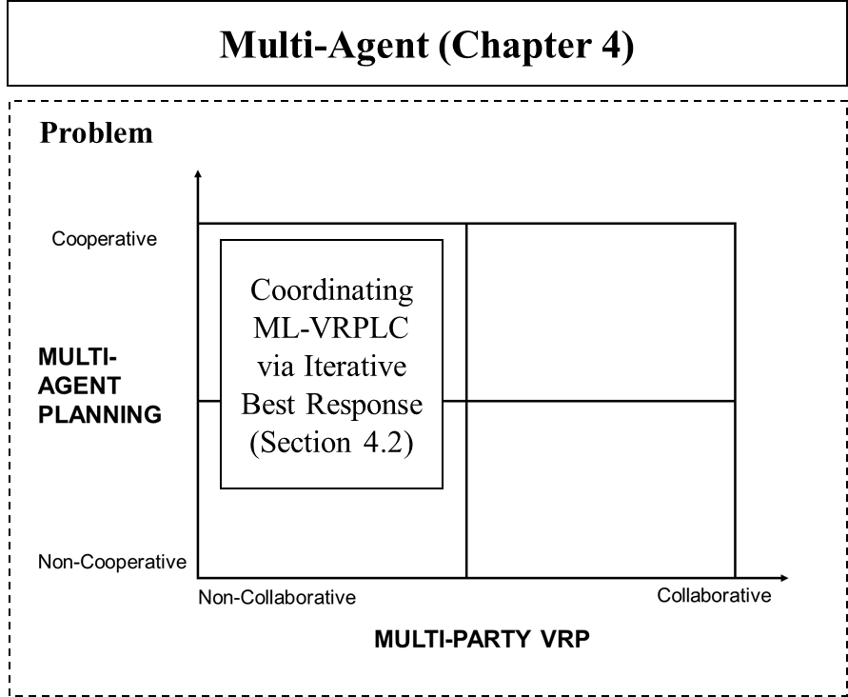
CONTRIBUTION TO EXISTING RESEARCH
MULTI-AGENT
New problem variant belonging to Intersection between Multi-Agent Planning Problem and Multi-Party VRP
Multi-Agent Planning
Cooperative vs Non-cooperative
[1] proposed multi-agent planning approach for loosely-coupled agents
Assume communication amongst agents
Not practical for our motivating problem
Mainly evaluated against benchmark problems
Collaborative VRP ^{[2]}
Exchange of goods mainly through auction
Only applicable if LSPs are collaborative
^{[1]} Nissim, R., Brafman, R.I.: Cost-optimal planning by self-interested agents. In: Twenty-Seventh AAAI Conference on Artificial Intelligence
(2013).
^{[2]} M. Gansterer and R. F. Hartl, “Collaborative vehicle routing: A survey”, European Journal of Operational Research, vol. 268, no. 1, pp. 1–12, 2018.
Notes:
problem belonging to an intersection between two main, well-studied research areas
Borrow ideas from both research domains
our work differs mainly from other existing works in that we apply techniques from other research domains (MAP and Game Theory) on a new variant of a well-studied optimization problem (VRP) with a real-world problem scale.

Slide 15







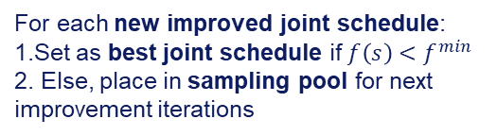
ITERATIVE BEST RESPONSE ALGORITHM
MULTI-AGENT
Improve the initial uncoordinated joint schedule by computing best response schedule of each LSP
For each new improved joint schedule:
1.Set as best joint schedule if $f\left(s\right)<f^{min}$
2. Else, place in sampling pool for next improvement iterations
Uncoordinated initial joint schedule
For each LSP, compute the best response schedule while the rest of LSPs follow the initial joint schedule
Notes:
To recap
Propose approach that combines elements from both research domains

Slide 16



ITERATIVE BEST RESPONSE ALGORITHM
MULTI-AGENT
At each improvement iteration, with certain probability, select the current best joint schedule or randomly sample from the pool and repeat the best response step.
Repeat this process until terminating conditions are met or when there is no more joint schedule to improve and return the best joint schedule
For the selected joint schedule, apply the best response step for each LSP and update the best solution and the sampling pool
Exploration vs Exploitation
Either improve the current best joint schedule or explore improvement paths of other joint schedule

Slide 17
BEST RESPONSE COMPUTATION
MULTI-AGENT
A metaheuristic as route optimizer with scheduler based on CP model
Adaptive Large Neighbourhood Search (ALNS) to search for better routes and CP model to produce a schedule that meets the resource and time-related constraints
Akin to solving single-LSP VRPLC
Route Optimizer + Scheduler

Slide 18
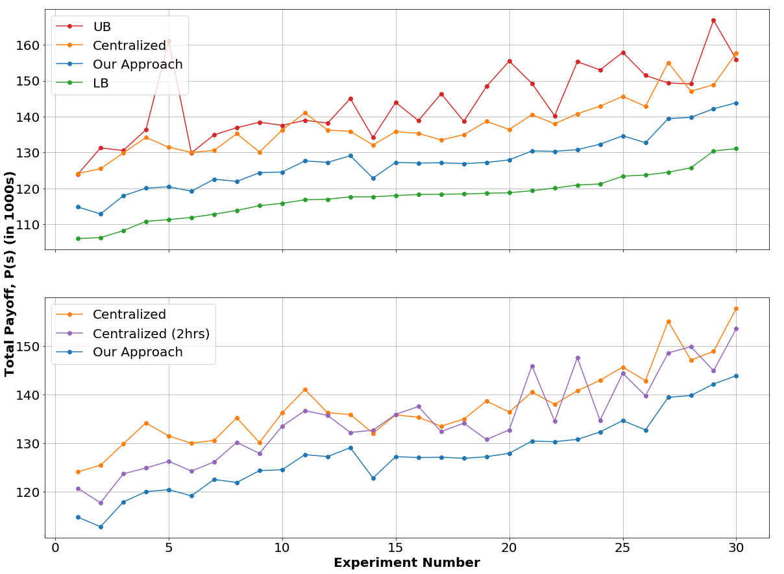
EXPERIMENTS
MULTI-AGENT
Our approach outperforms the centralized, non-collaborative planning approach even when its runtime is doubled.
Notes:
Here are some key observations from our experiment…
Our proposed approach is statistically able to produce decisions with highest success rate in 3 out of 4 sectors. The % refers to the % improvement over myopic approach.
Notice that in sector B, greedy approach performs the best. This means that the common notion of dispatching nearest available agent may only work so some specific cases.
Lastly, Myopic approach is observed to perform well in a problem setting with small numbers of agent and patrol areas (Sector C)
This is possibly due to the fact that the problem scale is small and too trivial that don’t require sophisticated / anticipatory policy

Slide 19
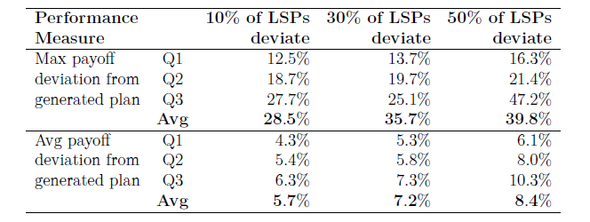
EXPERIMENTS
MULTI-AGENT
Sensitivity Analysis
Ensures enough incentive and deterrence for LSPs to adopt the coordinated planning
Robust against plan deviation
Notes:
Here are some key observations from our experiment…
Our proposed approach is statistically able to produce decisions with highest success rate in 3 out of 4 sectors. The % refers to the % improvement over myopic approach.
Notice that in sector B, greedy approach performs the best. This means that the common notion of dispatching nearest available agent may only work so some specific cases.
Lastly, Myopic approach is observed to perform well in a problem setting with small numbers of agent and patrol areas (Sector C)
This is possibly due to the fact that the problem scale is small and too trivial that don’t require sophisticated / anticipatory policy

Slide 20
MULTI-AGENT PATHFINDING ALGORITHM FOR AUTONOMOUS MOBILE ROBOT
PROPOSED APPROACH
EXPERIMENT RESULTS
Notes:
My next contribution relates to addressing the multi-agent nature of routing and scheduling

Slide 21
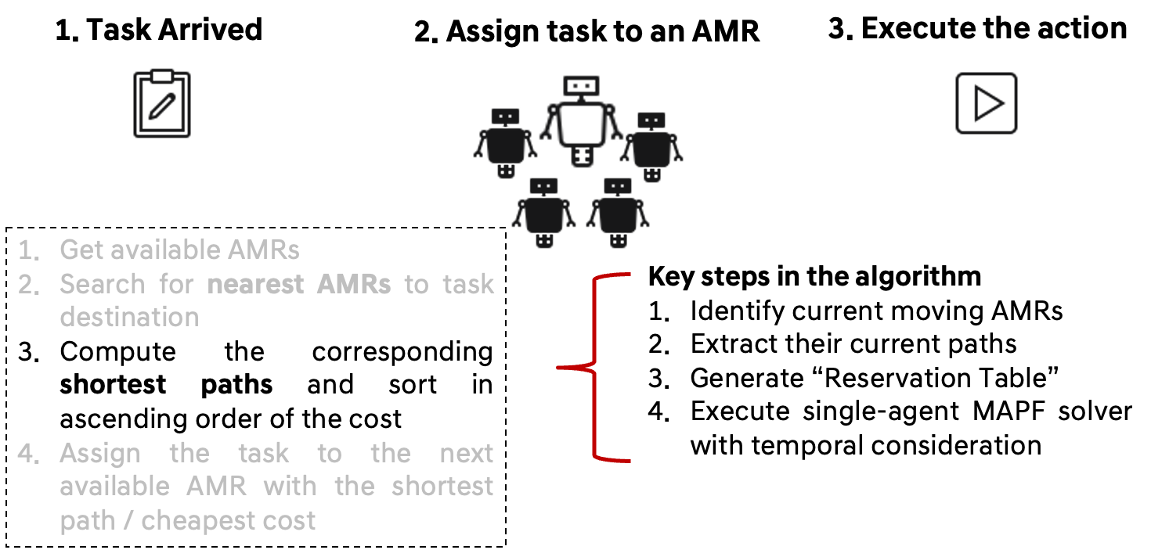
PROPOSED APPROACH
New Routing Algorithm
The new routing algorithm takes into account the paths of currently moving AMRs and compute the shortest path to avoid “clashing”
Assume the paths of other moving AMRs remains unchanged

Slide 22
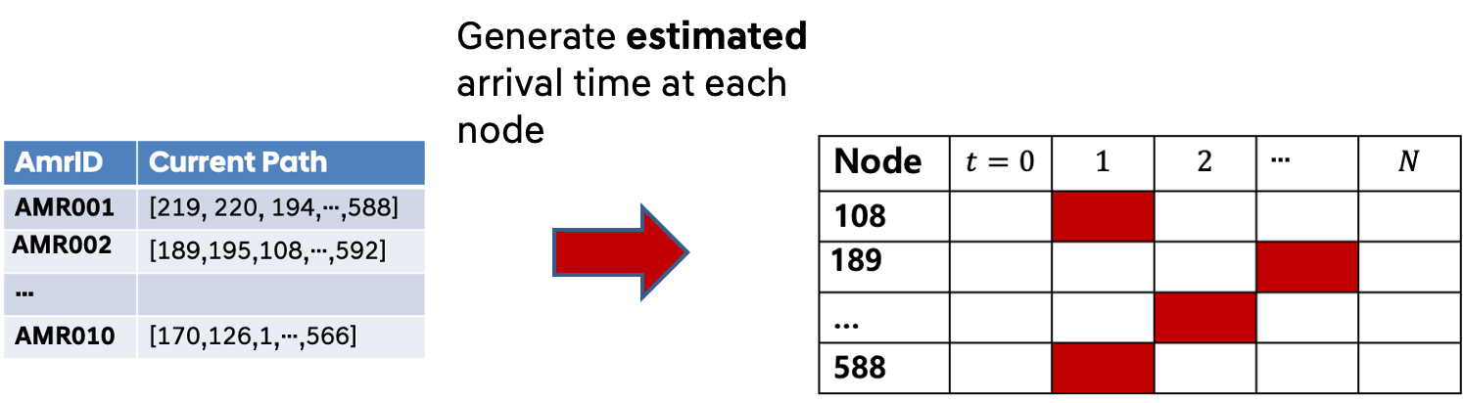
PROPOSED APPROACH
Reservation Table
Every Node has a capacity of one agent
Reservation table indicates the time where a given node is “reserved” and no other agent can occupy the node at that time
This is to avoid node conflict

Slide 23
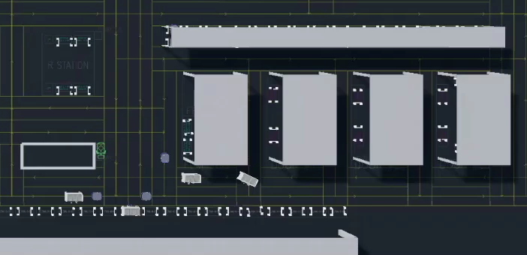
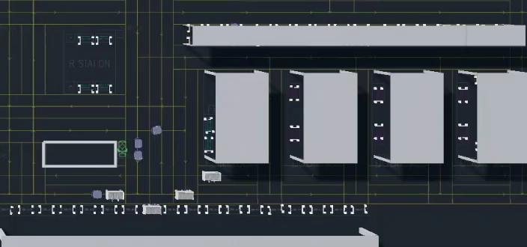
EXPERIMENT RESULTS
The new routing algorithm allows AMRs to take alternative paths to avoid congestion
Baseline
New
Congestion is more likely to occur since AMRs will always take the same shortest paths.
AMRs can take alternative paths to avoid the congestion.
This is an intended behaviour of the new algorithm.

Slide 24
SELECTED PUBLICATIONS
[1] W. Joe and H. C. Lau, “Deep reinforcement learning approach to solve dynamic vehicle routing problem with stochastic customers”, in Proceedings of the International Conference on Automated Planning and Scheduling, vol. 30, 2020, pp. 394–402.
[2] W. Joe and H. C. Lau, “Coordinating multi-party vehicle routing with location congestion via iterative best response”, in Multi-Agent Systems: 18th European Conference, EUMAS 2021, Virtual Event, June 28–29, 2021, Revised Selected Papers, Springer Nature, 2021.
[3] W. Joe, H. C. Lau, and J. Pan, “Reinforcement learning approach to solve dynamic bi-objective police patrol dispatching and rescheduling problem”, in Proceedings of the International Conference on Automated Planning and Scheduling, vol. 32, 2022, pp. 453–461.
[4] W. Joe, H. C. Lau,, “Learning to send reinforcements: coordinating multi-agent dynamic police patrol dispatching and rescheduling via reinforcement learning”. In Proceedings of the Thirty-Second International Joint Conference on Artificial Intelligence (pp. 153-161).
Notes:
The links to the paper and the videos can be found in my resume
In current work, we assume homogeneous agent and one single agent per incident
We focus on maximising joint shared reward, as shown in our evaluation on MADPRP, some agent suffer losses in order to help the other agent. Although the worst performing agent did better but is it fair for the rest?

Slide 25
THANK YOU Q&A
Notes:
I have come to the end of my defense.
The research work done in this thesis is by no mean exhaustive but it tries to address the current research gap in solving real-world problems and opens up new possibilities.
I hope my presentation has been an enriching one and pique your interest to build upon the work done here.

